Slide 1
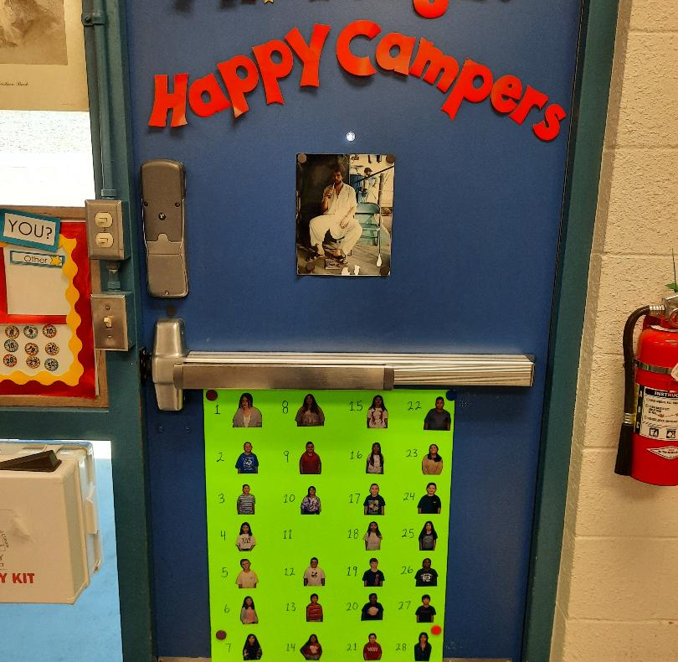
Back to School Night
2022 -2023

Slide 2
How to Contact Your Teacher
Mr. Tougas’ E-mail: Dave_Tougas@chino.k12.ca.us
Glenmeade Phone:
909-393-4087

Slide 3
Standards and Curriculum
Language Arts: McGraw Hill “Wonders” aligned to the Common Core State Standards. Digital platform is Connect ED.
Math: Pearson Realize aligned to the Common Core State Standards. Digital platform is Savvas Easy Bridge.
Science: Next Generation Science Standards (NGSS) Twig Science.
Social Studies: Reflections published by Harcourt School aligned with California State Standards
Social Emotional Learning: Second STEP

Slide 4
Additional Resources
Google Classroom- Writing assignments, project information, quizzes, games……
Prodigy- Play at school and at home. Standards from current topics are assigned.
Xtra Math- Math Fact Practice
Lexia- Leveled Reading Practice

Slide 5
CVUSD Grading Descriptors
4 - Excelling: Students at the Excelling level of performance are consistently performing at grade level, can demonstrate independence, and can extend the grade level standards, when applicable, expected a this point of the school year.
3 - Achieving: Students at the Achieving level of performance demonstrate an adequate understanding of and ability to apply skills needed to meet grade level standards at this point of the school year.
2 - Progressing: Students at the Progressing level of performance are partially meeting the grade level standards expected at this point of the school year.
1 - Beginning/Standard Not Met: Students at the Beginning/Standard Not Met level are not yet meeting grade level standards expected a this point of the school year.

Slide 6
What goes into the grades?
Curriculum based assessments
Teacher created assessments
Writing assignments
Classwork
Projects
Presentations
Class participation
Teacher observation

Slide 7
Homework
Assigned for practice and maintenance of skills
Monday through Thursday in Glenmeade folder
Math, Reading, and Spelling
Occasionally Science, Social Studies, Writing
One hour or less inclusive of 20-30 minutes of reading
Students fill out agenda daily
Parents please sign agenda daily and check the homework for neatness and completeness
Choice Slips issued for missed homework

Slide 8
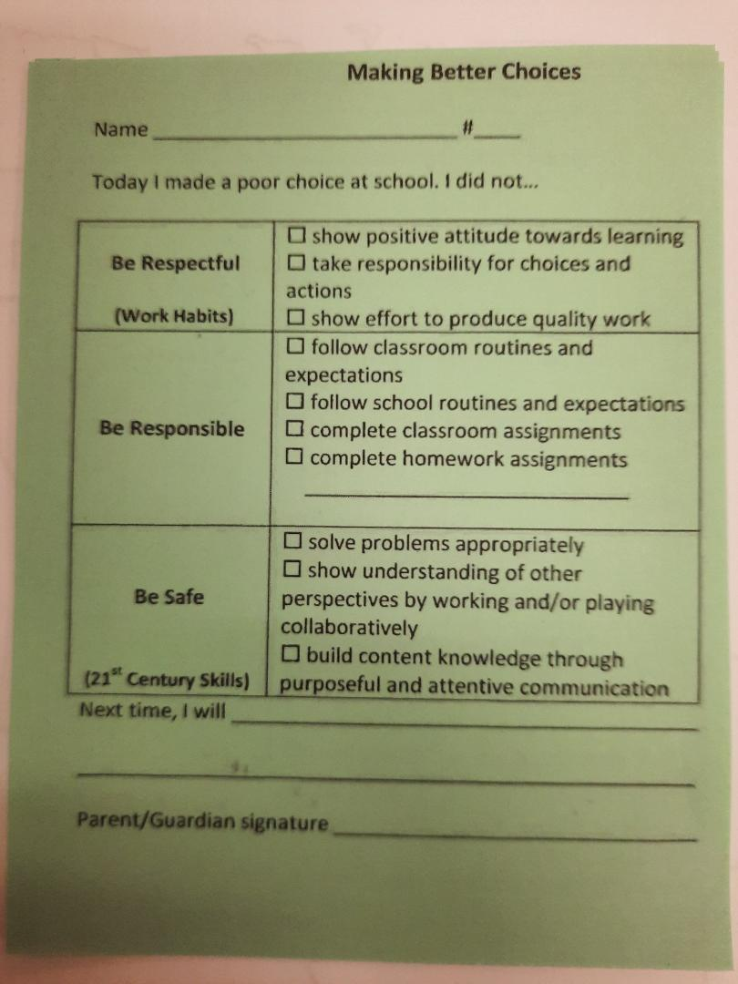
Monday Folder
Contains graded work and tests
Tally of choice slips if any (Choice Slips remain stapled in the Folder).
Flyers and handouts from PTA etc.
Weekly newsletter
Please remove papers and sign the folder
Return the next day

Slide 9
Assessments
District
Universal Screening for Reading and Math (FAST) 3 times per year.
Essential Standards Assessments for English Language Arts and Math (ESA) 3 times per year.
Writing Performance Tasks: Information, Opinion, Narrative One each trimester.
State
Math
English Language Arts
Science
Physical Fitness

Slide 10
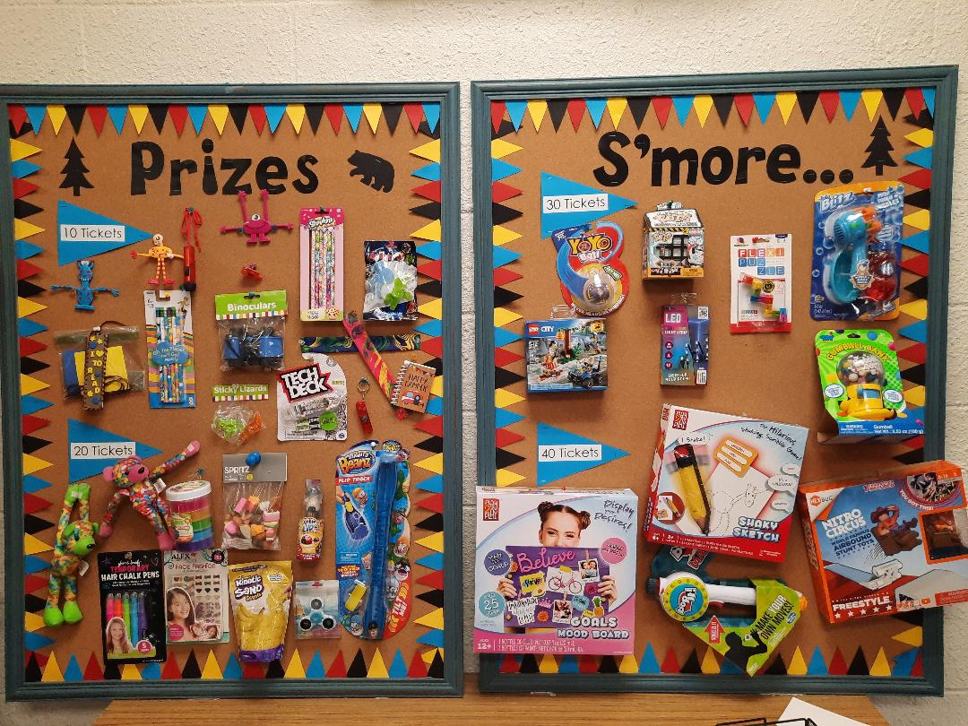
Positive Behavior Supports
Clear communication of Expectations with frequent acknowledgement.
Rowards and Wheel Spin Monday.
Class tickets awarded for following school routines/expectations. Tickets can be used to purchase prizes from the classroom store.
Team points: Ice Cream $1 , Pizza $2, Homework Pass.
Weekly Second Step Lessons – Empathy, Communication, Emotion Management

Slide 11
Consequences Continuum
Reminder of Expectations
Choice slip for repeated offense
Parent contact by phone or email
Referral to Administration for support ( Some behaviors go directly to administration ie: Theft, profanity, physical violence, racial slurs etc.)

Slide 12
PE
100 minutes per week
Wear appropriate shoes and clothing for running and playing. Shoes can be changed after if desired.
Participation is required unless there is a medical issue- parent note or email for short term. Doctor’s note for long-term.

Slide 13
Supplies
Please let your teacher know if you have difficulty obtaining supplies
Desks are crowded with books and folders so please no extras-Keep fancy stuff at home
Students need basics at home for homework and projects.
Donations to the class to replenish supplies are appreciated.

Slide 14
Volunteer Opportunities
Prior approval with vaccination or negative COVID test within the last 7 days.
Art Academy
Classroom Helper
Colonial Day

Slide 15
Other Items
Intervention and Resource- WIN time
Library – Weekly
Scholastic Books-Watch for flyers
Band-Beginning band currently enrolling
Accelerated Reader-Not yet active
Aeries- Please confirm data and update Parent Square to receive texts and emails

Slide 16
Administrative Information
The following slides are provided by the administration and pertain to school wide programs and policies.

Slide 17
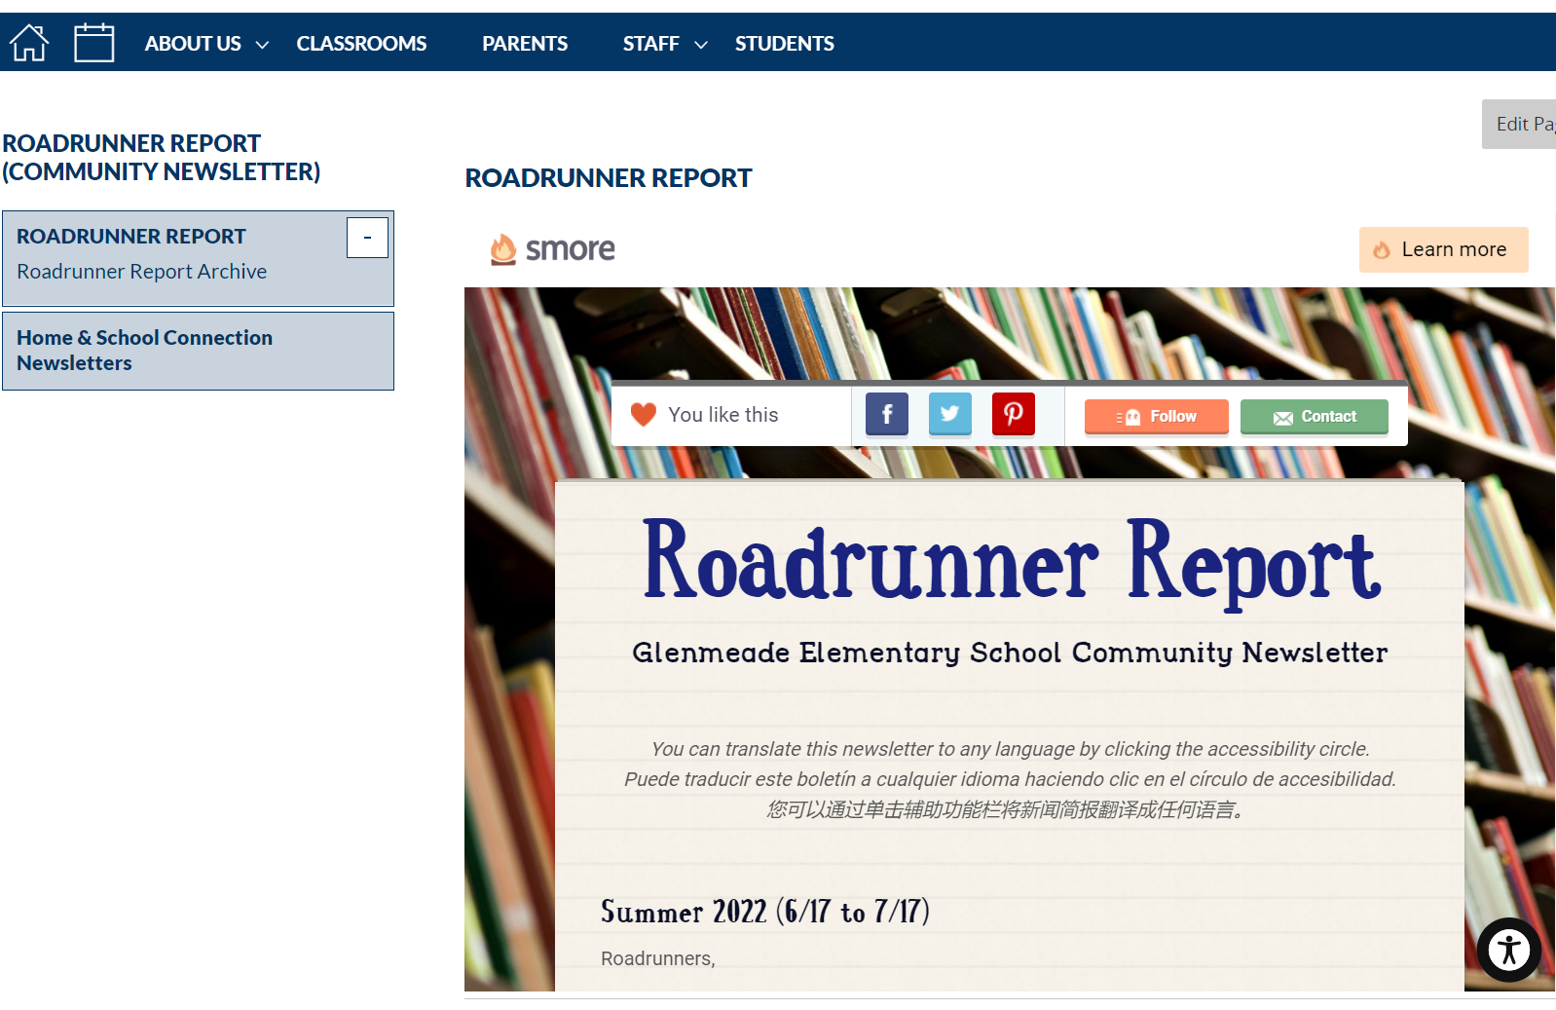
Communication
Glenmeade Website www.chino.k12.ca.us/Page/29
Weekly Newsletter
Every Saturday at 11:30 am
Notes:
We keep our website updated so please make a point to check it often. The weekly Roadrunner Report is sent out through Aeries Communication and Parent Square every Saturday at 11:30 am. It is also archived on our website.

Slide 18
Parent Handbook
Student Birthdays
& Class Treats
Birthdays can be an exciting time for students, and we want to recognize their special day; our teachers will do their best to verbally recognize birthdays. However, in order to minimize loss of instructional time, and to follow our wellness policy, treats and goodie bags are not to be brought to school. We ask that you do not place a teacher in an awkward position by asking them if you can have a party or bring in cupcakes, cakes, goodie bags, etc.
Gifts/balloons/flowers should not be sent to the school. If these items are brought to school, they will remain in the office until the end of the day.
Please read the provided handbook (English & Spanish) or reference the pdf copy online.
Notes:
Please read the provided handbook.

Slide 19
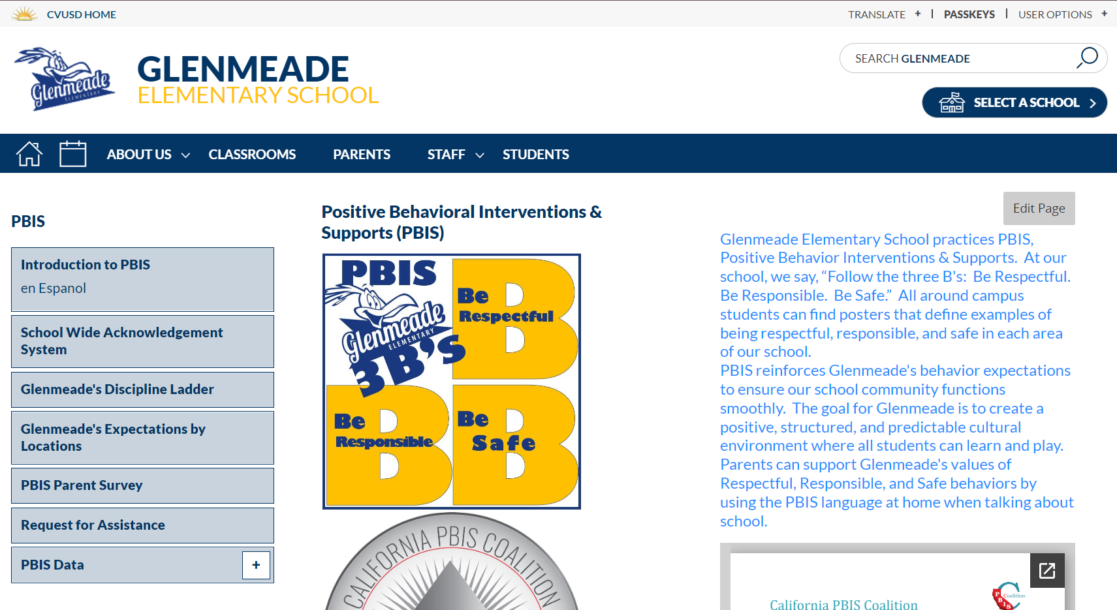
Glenmeade PBIS Expectations
Be Respectful
Be Responsible
Be Safe
Behavioral or emotional support requests

Slide 20
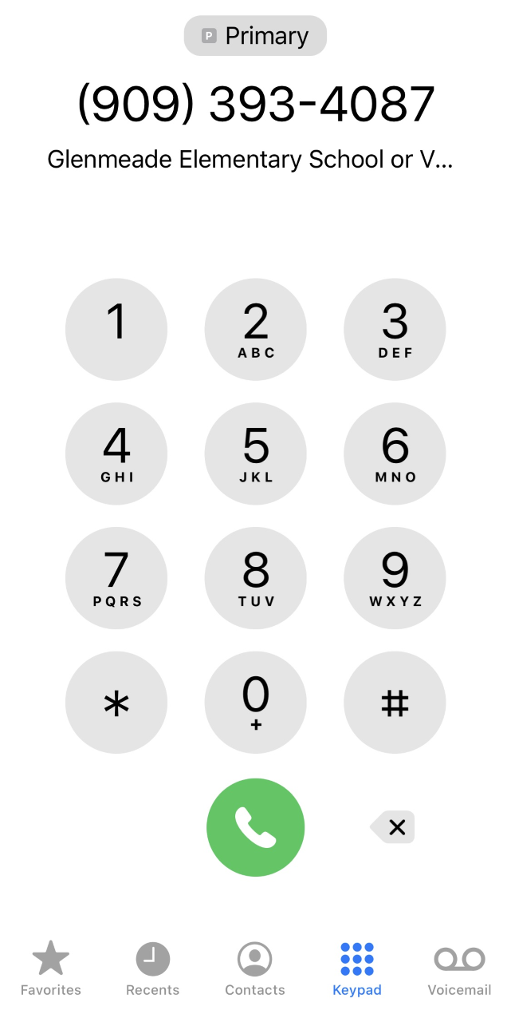
Attendance
Students are expected to be at school (unless it is an excused reason). Each day of school should provide an important learning experience, and if your child(ren) are not in class, they miss the learning continuity.
Board Policy requires a parent verification of each absence within 5 school days of the student’s return to school. On the sixth day, the absence becomes unverified and cannot be changed. State law requires that each absence be cleared.
Please contact the office at (909) 393-4087 to report absences.
Contacting the teacher about an absence is not the same as clearing the absence with the office.

Slide 21
CVUSD Grading Descriptors
4 - Excelling: Students at the Excelling level of performance are consistently performing at grade level, can demonstrate independence, and can extend the grade level standards, when applicable, expected a this point of the school year.
3 - Achieving: Students at the Achieving level of performance demonstrate an adequate understanding of and ability to apply skills needed to meet grade level standards at this point of the school year.
2 - Progressing: Students at the Progressing level of performance are partially meeting the grade level standards expected at this point of the school year.
1 - Beginning/Standard Not Met: Students at the Beginning/Standard Not Met level are not yet meeting grade level standards expected a this point of the school year.

Slide 22
5th&6th 1:1 Chromebooks
Charging towers/cabinets were installed in all classrooms last summer to store one device per student
Each student will be checked out a Chromebook for classroom use through our Destiny system (textbooks)
Chromebooks can go home
Personal headphones (inexpensive) can be sent to school and will be kept in a labeled bag for your student to use in the classroom

Slide 23
Aeries Parent Portal & Parent Square
Aeries Parent Portal and Parent Square are CVUSD’s communication tools.
ParentSquare is designed to keep parents informed and facilitate participation at schools. It provides a safe way for school principals, teachers, staff, and parents to communicate.
To activate your ParentSquare account, enter your Aeries Parent Portal, tap on Communications, and confirm the data you see there.
The Emergency Card is completed in Aeries Parent Portal. It is critical that you update your emergency contacts for each child so that we have someone to contact if you are unavailable.
Parent Square messages can be delivered in several forms, and parents may choose whichever is the most useful, practical version.
Email
Smartphone app
Phone (voice)
SMS (text) message
Web app within Aeries Parent Portal

Slide 24
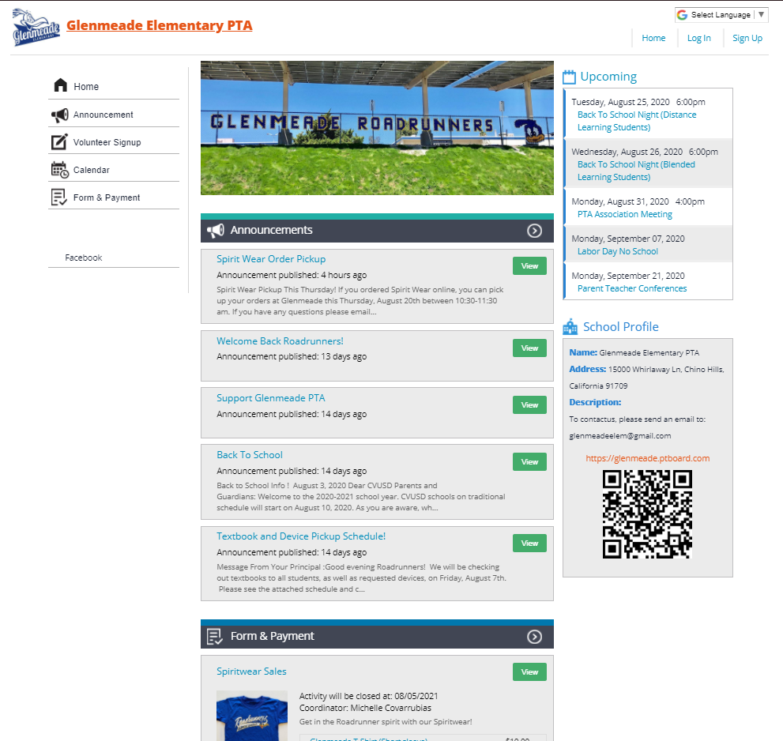
Glenmeade PTA Website
glenmeade.ptboard.com
Glenmeade has an outstanding PTA and strong parent involvement.
glenmeade.ptboard.com
Please consider joining the PTA this year. You can purchase your membership on the Glenmeade PTA website.
You can purchase spirit wear on the Glenmeade PTA website
Friday is Spirit Day!

